Slide 1
Ethical Issues in Social Research
Chapter 2

Slide 2
Research Ethics in Psychology
Ethics = principles that govern a person’s actions or behavior
Research Ethics = application of fundamental ethical principles to research activities

Slide 3
Research Ethics in Psychology
Two broad categories:
  How we treat participants
    “Do no harm”
  How we design our studies/interpret results:
    Biases/conflicts of interest
      Does the researcher have an “agenda?”
    Falsifying results (extreme)

Slide 4
Research Ethics in Psychology
Research is designed with the goal of protecting participants
  No harm, psychological or physical
  Human or animal
Psychologists are bound by the same broad ethical principles as physicians and other clinicians
Psychological Research is governed by Institutional Review Boards (IRBs)

Slide 5
Landis (1924)
Goal: Match human facial expressions to specific emotions
Had participants engage in a variety of tasks designed to elicit specific emotions
    Listening to Jazz
    Reading scripture
    Smelling ammonia
    Sticking their hands in a bucket of live frogs (unaware of frogs)
    Fired a gun in close proximity to the subjects
    Exposed them to pornography
    Handed them a live rat, a knife, and asked subject to decapitate the rate
Notes:
Sometimes the frog bucket had a live electrical wire at the bottom
Confronted with this high-stress situation, some persons started crying, others hysterically laughed; some completely froze, others burst out into swearing.

Slide 6


Slide 7

The Stanford Prison Experiment (1971)
Simulated a prison environment
  Individuals randomly selected to be “guards” or “prisoners”
  Given uniforms, fully thrown into roles
  “Guards” engaged in all sorts of psychological abuse towards “prisoners”

Slide 8
Protecting Participants
Protecting the rights of human subjects is a problem unique to psychology
Ethical treatment of animals (psychology, biology, etc.)
Notes:
Astronomers’, chemists, physicists, etc. don’t have to worry about these things…

Slide 9
Other Ethical Considerations
Harm must be prevented: Participants cannot experience any serious or lasting harm
Privacy: Data must be anonymous and/or protected

Slide 10
Other Considerations: Deception
Deception: Providing participants with false information about experimental procedures
  Confederates: People who act as though they are participants in the experiment but are really working for experimenter.

Slide 11
National Research Act (1974)
In 1974, U.S. Department of Health, Education, and Welfare established regulations designed to protect human participants in research.
Created institutional review boards (IRBs) to ensure that the welfare of participants is adequately protected

Slide 12
Institutional Review Boards
Researchers must abide by profession’s code of ethics.
Must obtain informed consent
  Informed consent may not be necessary in some cases.
Guidelines:
  Informed Consent
  Confidentiality
  Debriefing

Slide 13
Informed Consent
Consent form must include:
  Purpose of the study
  Direct benefits of participation
    Compensation
    Other benefits
  Inherent Risks
    Injury?
    Psychological damage?
    Slight boredom?

Slide 14
Informed Consent
Informed consent ensures Voluntary Participation
  No one should be forced to participate.
  Participants should be free to quit a study at any time
  Participant must consent before they can start the study!

Slide 15
Confidentiality
Anonymity and Confidentiality
  Not the same thing!
Anonymity – Neither the researchers nor the readers of the findings can identify a given response with a given respondent.
Confidentiality – Researcher can identify a given person’s responses but promises not to do so publicly.

Slide 16
Debriefing
At the end of their participation, participants are informed of:
  The nature of the research
  All procedures, including an explanation of exactly what happened and why
  The purpose of the research
  Any deceptions that were used
Especially important when deception is used!

Slide 17
Ethics and Consent Online
Loss of privacy has opened the window for corporations, marketers, and researchers to peek in to record actions in ways that raise new questions about ethics
“To Facebook, we are all lab rats” (Goel, 2014)
Consent given when they agree to its terms of service

Slide 18
Other Ethical Considerations
Researcher Bias:
  Occurs when researcher skews process towards finding a specific outcome
Not always deliberate!
Could be unconscious!
  Example: Constructing a survey on the negative effects of alcohol

Slide 19
Researcher Bias
Types of Researcher Bias:
  Design bias: Research design is largely influenced by personal preferences rather than what’s best for a study
  Example: Survey of drug effectiveness
    Do questions overly hype negative side effects?
  Participant Selection Bias: Selecting participants based on how you think they’ll perform

Slide 20
Ethical Reporting of Results
Ethical obligation to colleagues in the scientific community.
All results must be reported (positive and negative).
All limitations must be admitted.

Slide 21
Publishing Research Findings
Ultimate goal of research: Publication in a Scientific journal!
Why?
  Prestige
  Tenure
  Job prospects
For better or worse, publications are used as “academic currency”
  Measure of success as a scientist

Slide 22
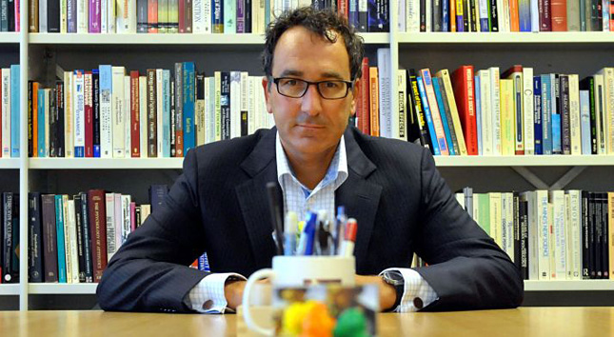
The other side of Research Ethics: Research Fraud
Notes:
Dutch Social Psychologist
Very successful, highly publicized work:
Much of his work was based on fake data…
Active from 1997 – 2011
At least 30 papers were retracted!
Eventually got caught after other researchers started questioning how he always got perfect results…
Trash-filled environments bring out racist tendencies in individuals
Individuals who eat meat tend to be less social and more selfish

Slide 23
Diederik Stapel
How did he get away with it for so long?
  His students never collected their own data. He provided them with datasets to analyze
  Position of power
  Science involves lots of solo work w/ little oversight

Slide 24
Combatting Research Fraud
Preregistration
  The practice of researchers reporting their research design, predictions, and plans for data analyses before conducting their study.
  Stick to the plan, regardless of what happens!
Open Science Practices
  Data is freely shareable with other researchers
  Idea is that any one can inspect your data, materials, etc.
  Transparency should cut down on fraud

